Slide 1

ECGEASY
BY: ASHLEY OAKES, SANA KHAN, NAVYA ROY

Slide 2

Introduction:
The total number of deaths per year to cardiovascular diseases is about 17.3 billion a year according to the WHO causes of death. In this project we plan to develop a machine learning system that can classify a patient into different arrhythmic classes. You can diagnose a cardiac arrhythmia based on an Electrocardiogram (ECG). Our first class refers to a patient that has a normal sinus rhythm, while the other classes represent abnormal rhythms such as Bradycardia, Tachycardia, Afib/ A-flutter. This is a supervised learning project.

Slide 3
FRAMINGHAM DATA CATEGORIES
1) Male/Female
2) Age
3) Education
4) Current Smoker
5) “Cigs” per day
6) BP Meds
7) Prevalent Stroke
8) Prevalent Hyp
9) Diabetes
10) Total Cholesterol
11) Sys BP
12) “DiaBP”
13)BMI
14) Heart Rate
15) Glucose
16) Ten Year CHD

Slide 4
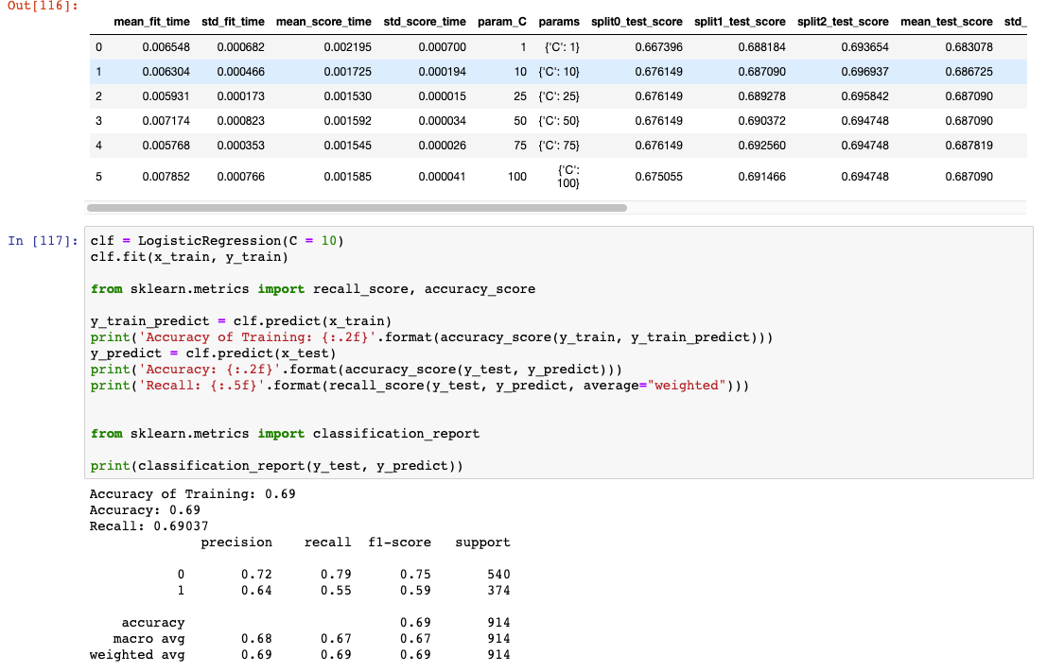
Logistic Regression
Accuracy Score-.69

Slide 5
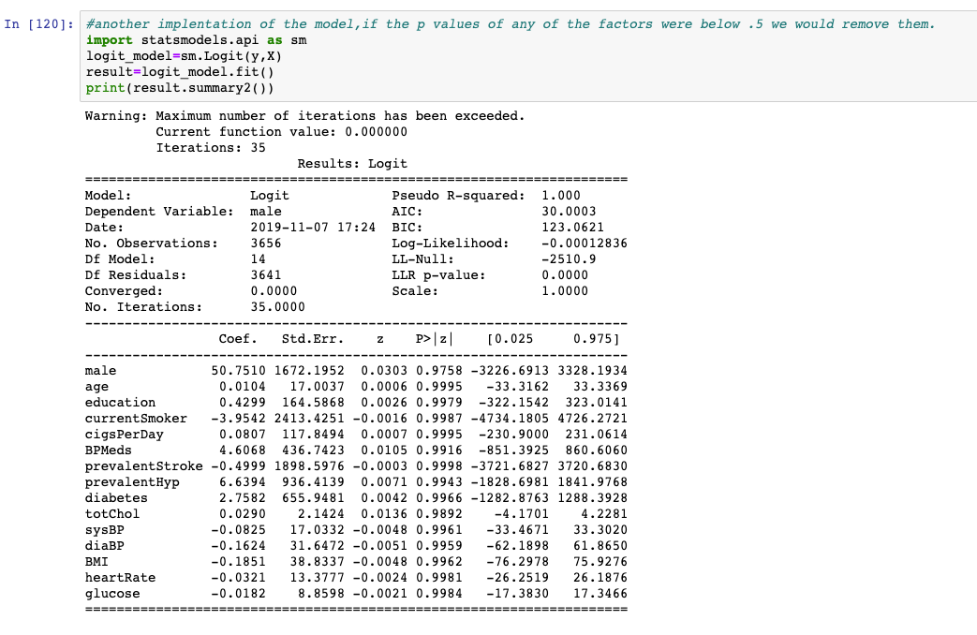
Logistic Regression
Another Implementation of the Logistic model where we wanted to see if any of the p-values were under .5

Slide 6
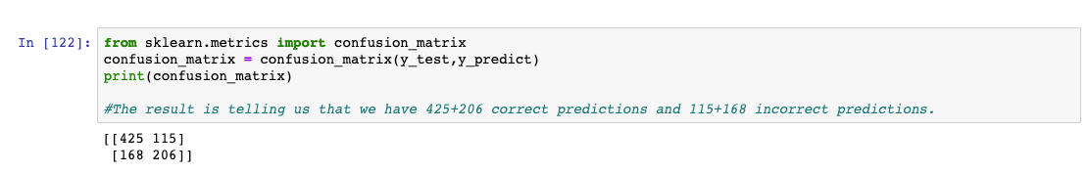
Logistic Regression
We created a confusion matrix to see the number of correct and incorrect predictions.
631 correct predictions
283 incorrect predictions

Slide 7
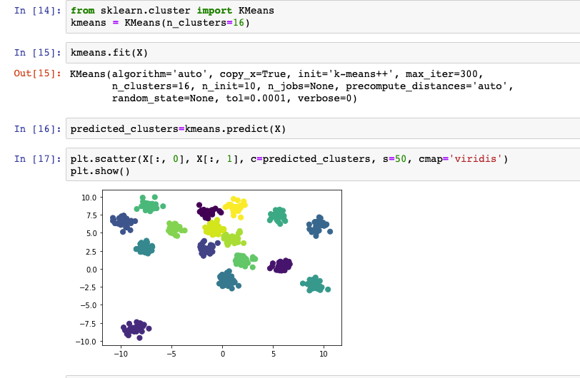
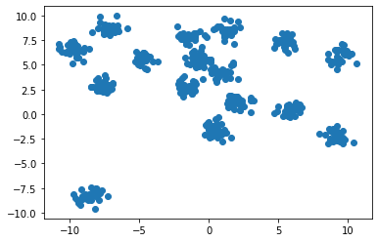
K-Means Clustering

Slide 8
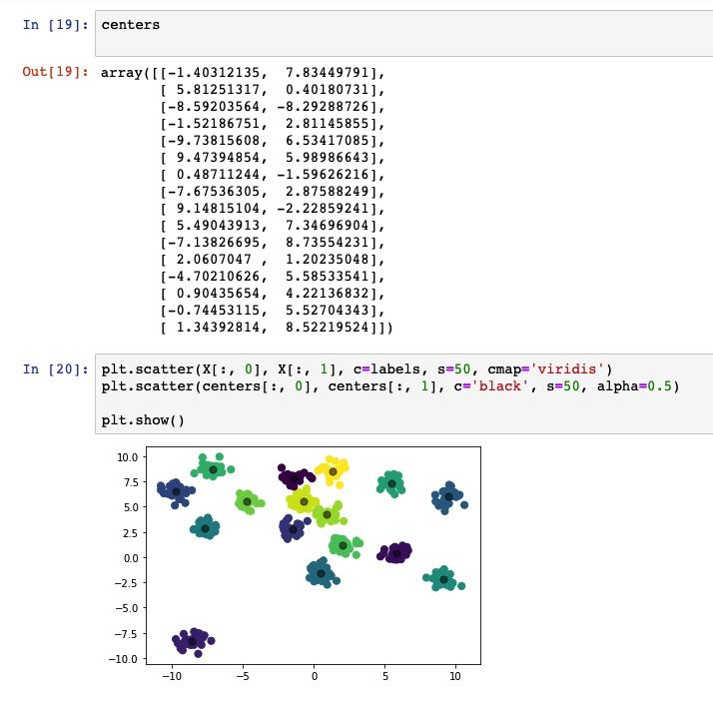
K-Means Clustering

Slide 9
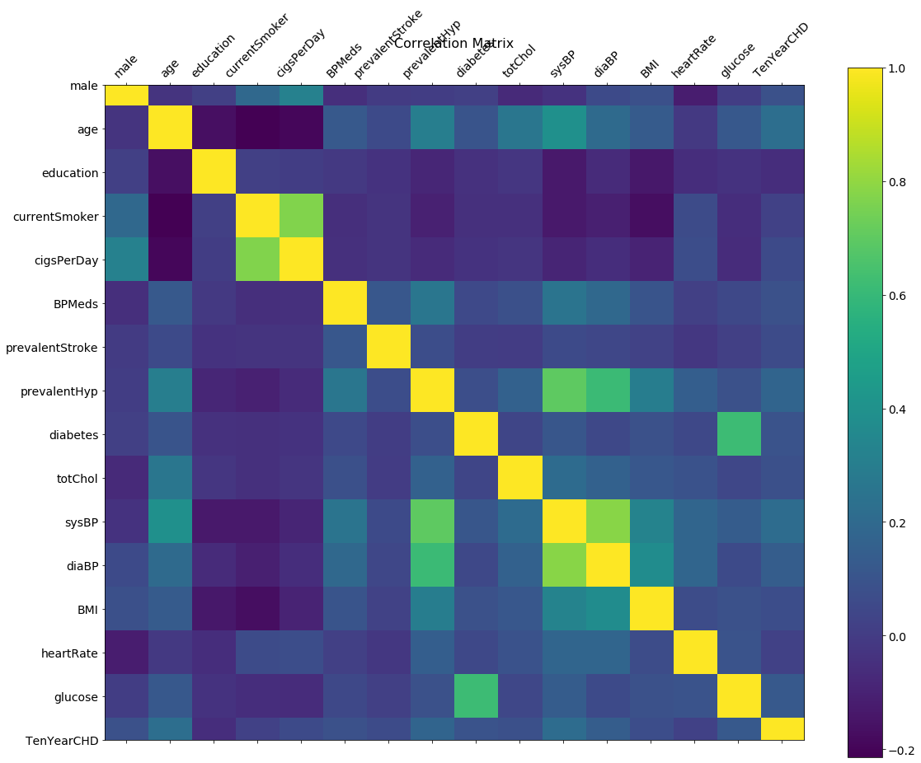
K-Means Clustering

Slide 10
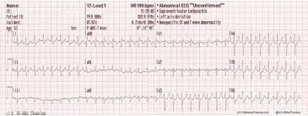
Classifying Arrhythmias:
In this project we wanted to classify Arrhythmias into 16 categories:
1) Normal Sinus Rhythm - 245
2) Ischemic Changes (Coronary Heart Disease) – 44
3) /4) Old Anterior Myocardial Infarction – 15
5) Sinus Tachycardia – 13
6) Sinus Bradycardia – 25
7) Premature Ventricular Contraction (PVC) – 3
8) Supraventricular Premature Contraction - 2
9) Left BBB – 9
10) Right BBB – 50
11)/ 12)/ 13) 1st, 2nd, 3rd AVB
14) Left Ventricular Hypertrophy
15) Afib or A- Flutter – 5
16) Other – 22

Slide 11
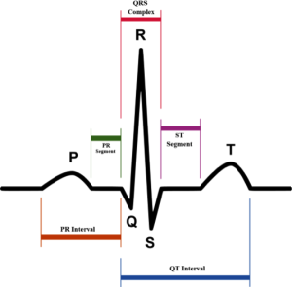
ECG GRAPH
P– is the atrial systole contraction pulse
Q – is a downward deflection immediately preceding the ventricular contraction
R- the peak of ventricular contraction
S- the downward deflection immediately after the ventricular contraction
T- the recovery of the ventricles
U- is the successor of the T wave but it is small and not always observed

Slide 12
FEATURE SELECTION:
First we removed categorical features that had all 0’s and all 1’s
If there was an attribute that had values missing, we then discarded that attribute and removed it from our training set.
The features can be grouped into 5 blocks:
Biogeographical features (age, sex, height, weight, heart rate)
Avg. wave length durations of each interval (PR interval, QRS complex, and ST intervals)
Features of vector angles of each wave
Features concerning the width of each wave
Features pertaining to the amplitude of each wave

Slide 13
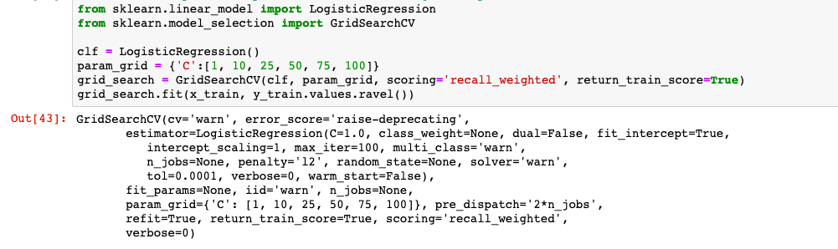
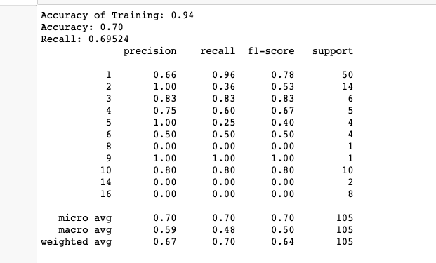
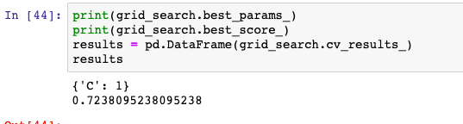
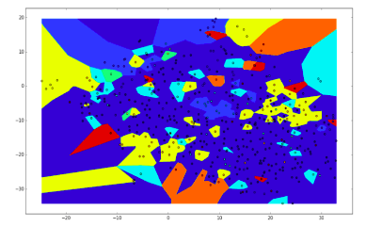
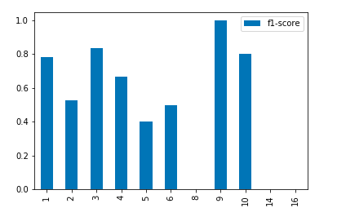
LOGISTIC REGRESSION FOR PREDICTING ARRHYTHMIAS

Slide 14
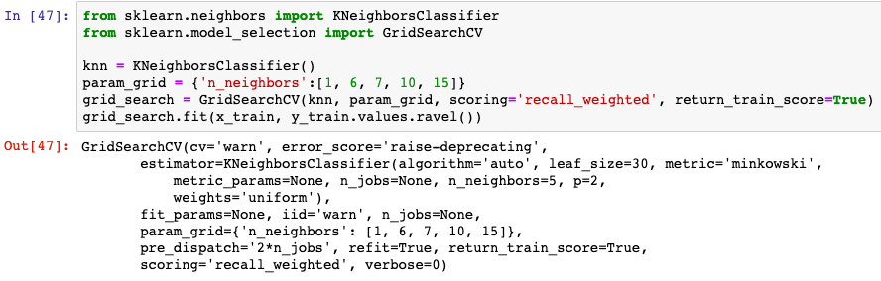
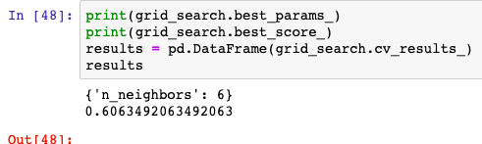
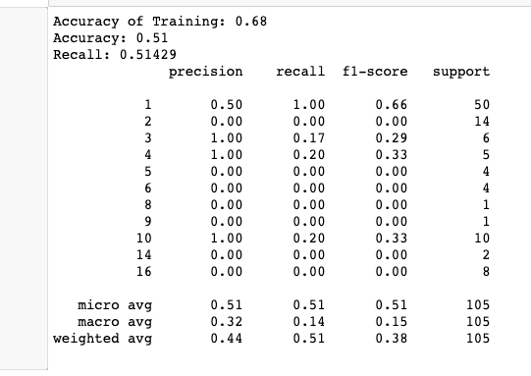
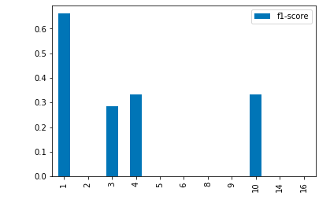
KNN CLASSIFIER FOR PREDICTING ARRHYTHMIAS

Slide 15
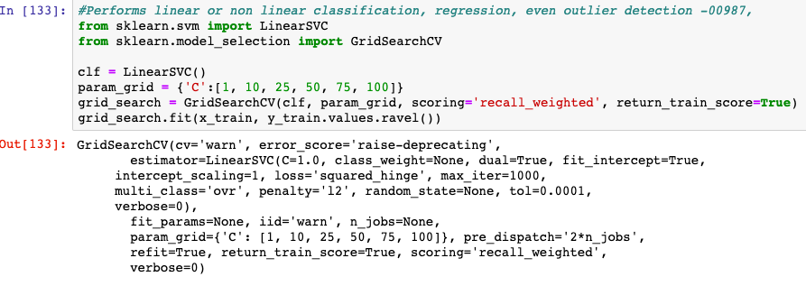
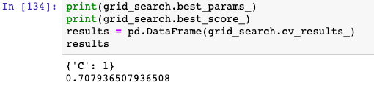
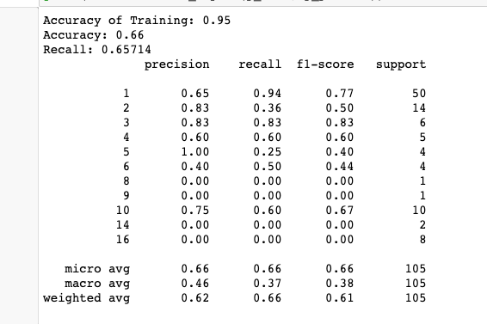
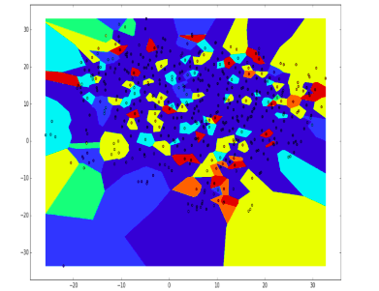
SUPPORT VECTOR MACHINE FOR PREDICTING ARRHYTHMIAS

Slide 16
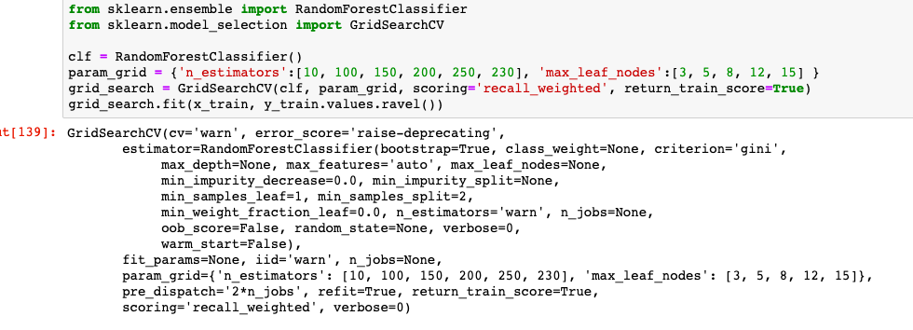
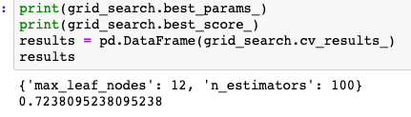
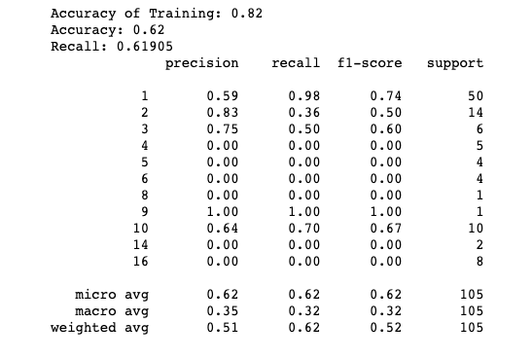
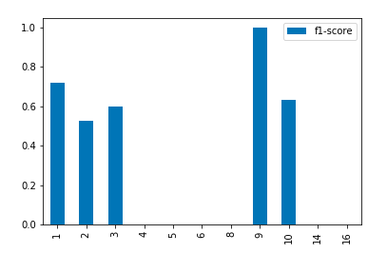
RANDOM FOREST FOR PREDICTING ARRHYTHMIAS

Slide 17
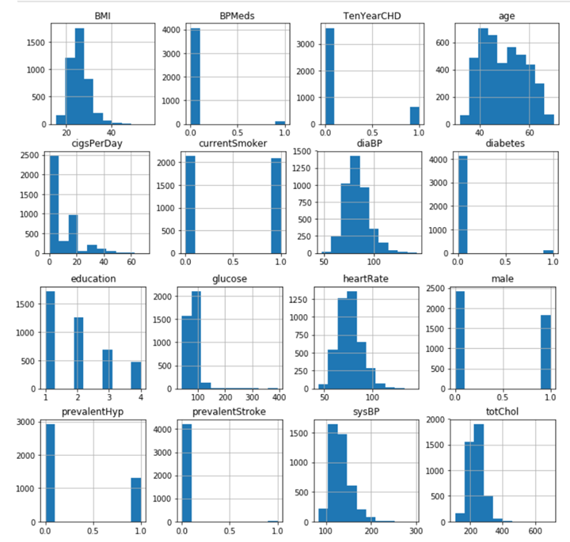

Slide 18
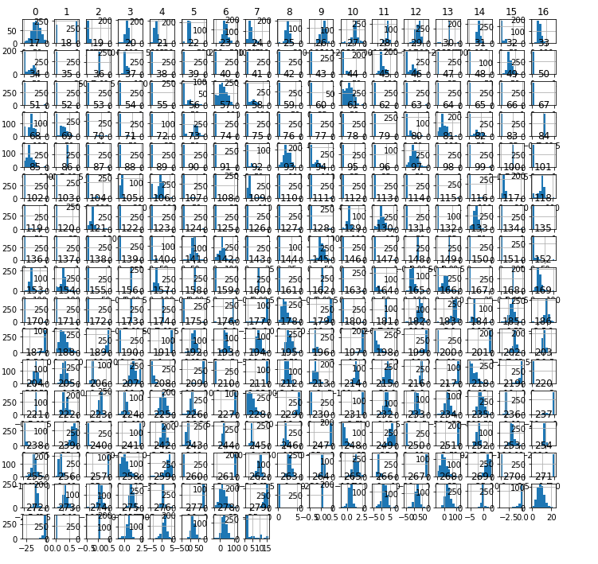

Slide 19
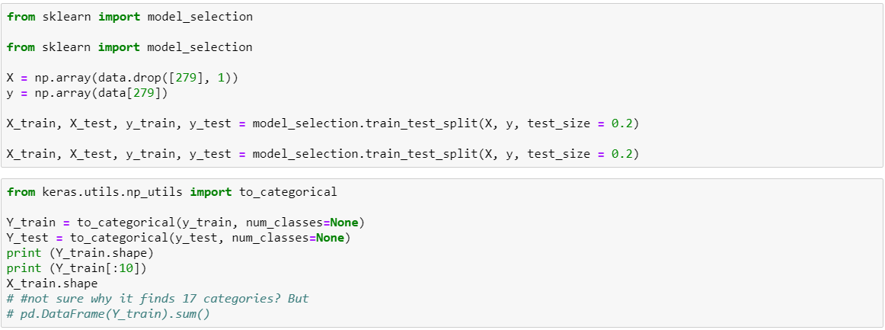
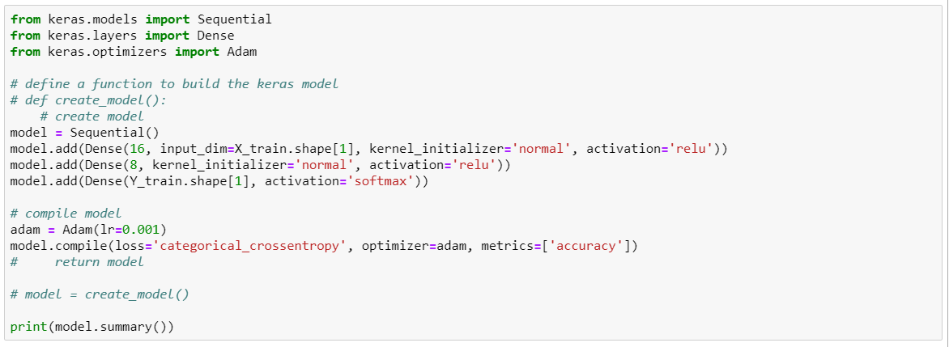
Neural Network

Slide 20
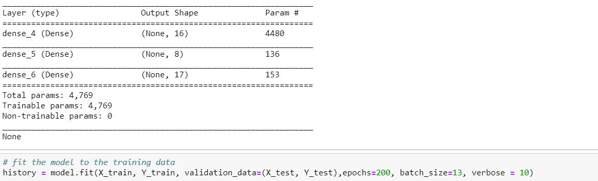
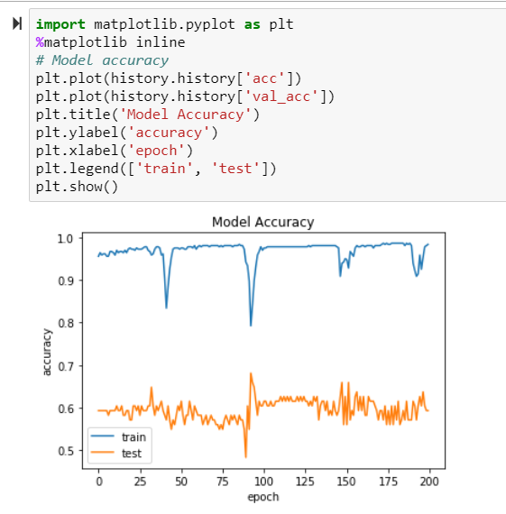
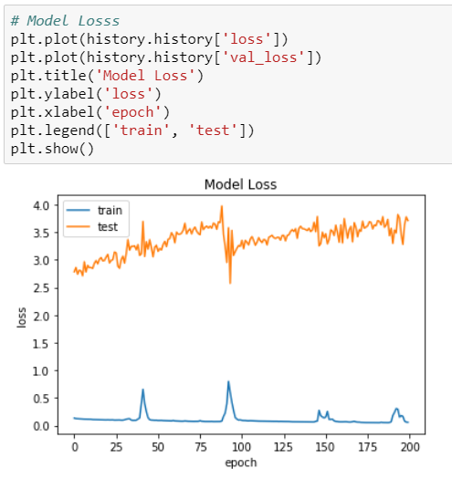

Slide 21
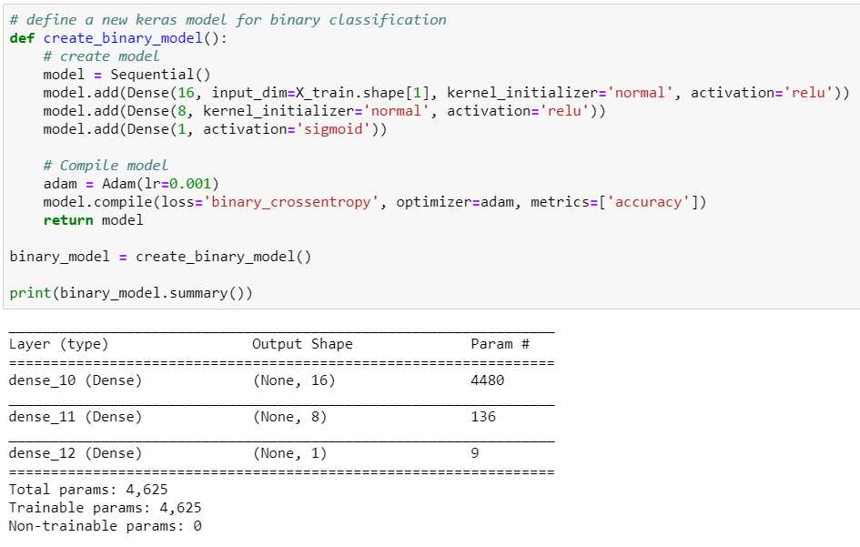

Slide 22
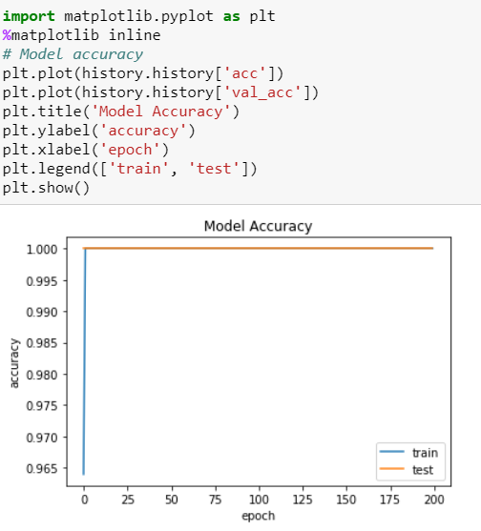
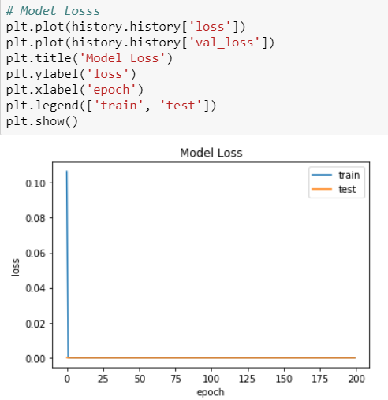

Slide 23
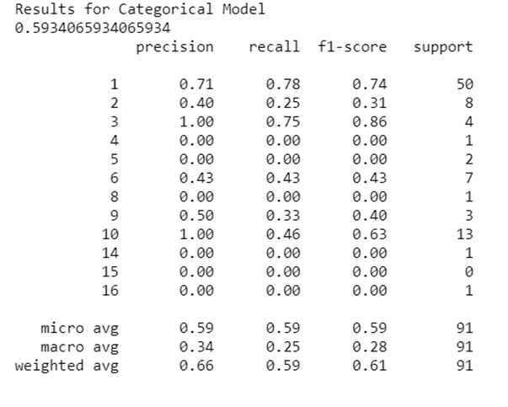
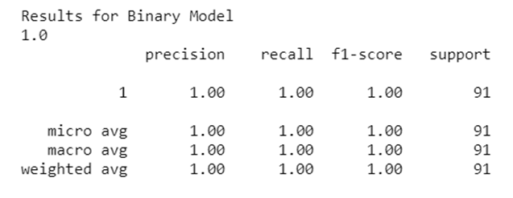

Slide 24
REFERENCES:
UCI Machine Learning Repository
Heart Disease Prediction Data From Kaggle

